Slide 1
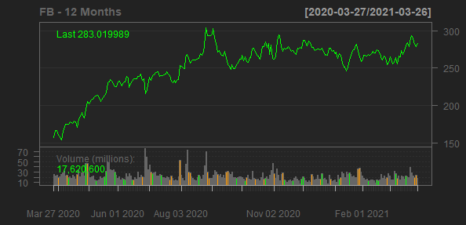
Facebook, Inc.
FB
Sector: Communication Services
Industry: Internet Content & Information
Facebook, Inc. develops products that enable people to connect and share with friends and family through mobile devices, personal computers, virtual reality headsets, and in-home devices worldwide. The company's products include Facebook that enables people to connect, share, discover, and communicate with each other on mobile devices and personal computers; Instagram, a community for sharing photos, videos, and private messages; Messenger, a messaging application for people to connect with friends, family, groups, and businesses across platforms and devices; and WhatsApp, a messaging application that is used by people and businesses to communicate in a private way. It also provides Facebook Reality Labs, an augmented and virtual reality product that help people feel connected, anytime, and anywhere. Facebook, Inc. was founded in 2004 and is headquartered in Menlo Park, California.
Sales Growth
EBIT Margin
37.35%
50%
49.7%
44.62%
30%
40%
41%
38.01%
26.61%
21.6%
30%
20%
EBIT Margin
Sales Growth
20%
10%
10%
0%
0%
2018-12-31
2019-12-31
2020-12-31
2017-12-31
2018-12-31
2019-12-31
2020-12-31
Date
Date

Slide 2
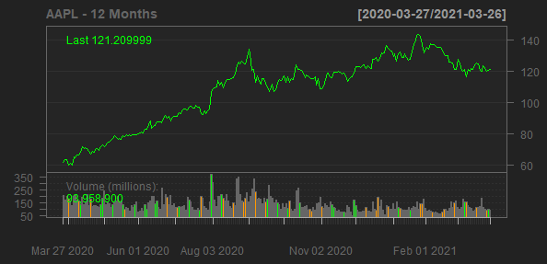
Apple Inc.
AAPL
Sector: Technology
Industry: Consumer Electronics
Apple Inc. designs, manufactures, and markets smartphones, personal computers, tablets, wearables, and accessories worldwide. It also sells various related services. The company offers iPhone, a line of smartphones; Mac, a line of personal computers; iPad, a line of multi-purpose tablets; and wearables, home, and accessories comprising AirPods, Apple TV, Apple Watch, Beats products, HomePod, iPod touch, and other Apple-branded and third-party accessories. It also provides AppleCare support services; cloud services store services; and operates various platforms, including the App Store, that allow customers to discover and download applications and digital content, such as books, music, video, games, and podcasts. In addition, the company offers various services, such as Apple Arcade, a game subscription service; Apple Music, which offers users a curated listening experience with on-demand radio stations; Apple News+, a subscription news and magazine service; Apple TV+, which offers exclusive original content; Apple Card, a co-branded credit card; and Apple Pay, a cashless payment service, as well as licenses its intellectual property. The company serves consumers, and small and mid-sized businesses; and the education, enterprise, and government markets. It sells and delivers third-party applications for its products through the App Store. The company also sells its products through its retail and online stores, and direct sales force; and third-party cellular network carriers, wholesalers, retailers, and resellers. Apple Inc. was founded in 1977 and is headquartered in Cupertino, California.
Sales Growth
EBIT Margin
15.86%
26.76%
26.69%
15%
24.57%
24.15%
20%
10%
Sales Growth
5.51%
EBIT Margin
5%
10%
0%
-2.04%
0%
2018-09-29
2019-09-28
2020-09-26
2017-09-30
2018-09-29
2019-09-28
2020-09-26
Date
Date

Slide 3
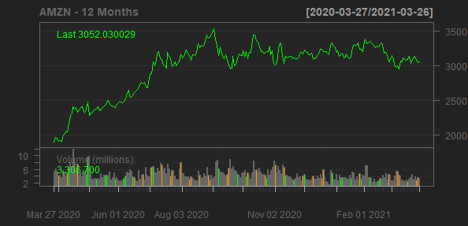
Amazon.com, Inc.
AMZN
Sector: Consumer Cyclical
Industry: Internet Retail
Amazon.com, Inc. engages in the retail sale of consumer products and subscriptions in North America and internationally. The company operates through three segments: North America, International, and Amazon Web Services (AWS). It sells merchandise and content purchased for resale from third-party sellers through physical and online stores. The company also manufactures and sells electronic devices, including Kindle, Fire tablets, Fire TVs, Rings, and Echo and other devices; provides Kindle Direct Publishing, an online service that allows independent authors and publishers to make their books available in the Kindle Store; and develops and produces media content. In addition, it offers programs that enable sellers to sell their products on its websites, as well as its stores; and programs that allow authors, musicians, filmmakers, skill and app developers, and others to publish and sell content. Further, the company provides compute, storage, database, analytics, machine learning, and other services, as well as fulfillment, advertising, publishing, and digital content subscriptions. Additionally, it offers Amazon Prime, a membership program, which provides free shipping of various items; access to streaming of movies and TV episodes; and other services. The company serves consumers, sellers, developers, enterprises, and content creators. Amazon.com, Inc. was founded in 1994 and is headquartered in Seattle, Washington.
Sales Growth
EBIT Margin
37.62%
6%
5.93%
5.33%
5.13%
30%
30.93%
4%
20%
20.45%
Sales Growth
EBIT Margin
2.31%
2%
10%
0%
0%
2018-12-31
2019-12-31
2020-12-31
2017-12-31
2018-12-31
2019-12-31
2020-12-31
Date
Date

Slide 4
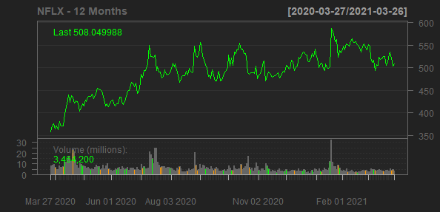
Netflix, Inc.
NFLX
Sector: Communication Services
Industry: Entertainment
Netflix, Inc. provides entertainment services. It offers TV series, documentaries, and feature films across various genres and languages. The company provides members the ability to receive streaming content through a host of Internet-connected devices, including TVs, digital video players, television set-top boxes, and mobile devices. It also provides DVDs-by-mail membership services. The company has approximately 204 million paid members in 190 countries. Netflix, Inc. was founded in 1997 and is headquartered in Los Gatos, California.
Sales Growth
EBIT Margin
35.08%
18.34%
30%
27.62%
15%
24.01%
12.92%
20%
10%
10.16%
Sales Growth
EBIT Margin
7.17%
10%
5%
0%
0%
2018-12-31
2019-12-31
2020-12-31
2017-12-31
2018-12-31
2019-12-31
2020-12-31
Date
Date

Slide 5
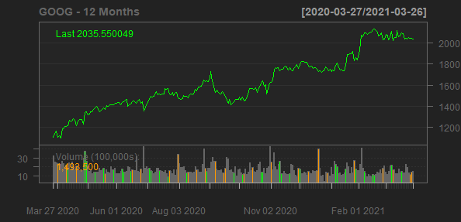
Alphabet Inc.
GOOG
Sector: Communication Services
Industry: Internet Content & Information
Alphabet Inc. provides online advertising services in the United States, Europe, the Middle East, Africa, the Asia-Pacific, Canada, and Latin America. The company offers performance and brand advertising services. It operates through Google Services, Google Cloud, and Other Bets segments. The Google Services segment provides products and services, such as ads, Android, Chrome, hardware, Google Maps, Google Play, Search, and YouTube, as well as technical infrastructure; and digital content. The Google Cloud segment offers infrastructure and data analytics platforms, collaboration tools, and other services for enterprise customers. The Other Bets segment sells internet and TV services, as well as licensing and research and development services. The company was founded in 1998 and is headquartered in Mountain View, California.
Sales Growth
EBIT Margin
23.42%
26.08%
23.82%
22.54%
22.59%
20%
18.3%
20%
15%
12.77%
Sales Growth
EBIT Margin
10%
10%
5%
0%
0%
2018-12-31
2019-12-31
2020-12-31
2017-12-31
2018-12-31
2019-12-31
2020-12-31
Date
Date

